Slide 1
Logical Representations of Sentence Meaning

Slide 2
Background
Meaning representations
  The meaning of linguistic expressions can be captured in formal structures
  Consider tasks that require some form of semantic processing, like learning to use a new piece of software by reading the manual, deciding what to order at a restaurant by reading a menu, or following a recipe.
Semantic Parsing or Semantic Analysis
  linguistic expressions have meaning representations that are made up of the same kind of stuff that is used to represent this kind of everyday common-sense knowledge of the world. The process whereby such representations are created and assigned to linguistic inputs is called semantic parsing or semantic parsing semantic analysis, and the entire enterprise of designing meaning representations and associated semantic parsers is referred to as computational semantics.

Slide 3
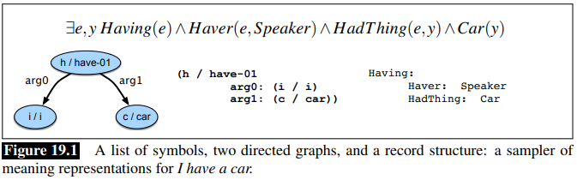
I have a car using four commonly used meaning representation languages

Slide 4
Computational Desiderata for Representations
Considering the issue of why meaning representations are needed and what they should do for us
  Verifiability
  Unambiguous representations
  Canonical form
  Inference and variables
  Expressiveness

Slide 5
Computational Desiderata for Representations
Verifiability
Consider the following simple question:
Does Maharani serve vegetarian food?
To answer this question, we have to know what it’s asking, and know whether what it’s asking is true of Maharini or not.
Verifiability is a system’s ability to compare the state of affairs described by a representation to the state of affairs in some world as modeled in a knowledge base
Serves(Maharani,VegetarianFood), which a system can match against its knowledge base of facts about particular restaurants, and if it finds a representation matching this proposition, it can answer yes.

Slide 6
Unambiguous representations
Semantics, like all the other domains is subject to ambiguity.
Words and sentences have different meaning representations in different contexts.
Consider the following example:
I wanna eat someplace that’s close to ICSI
This sentence can either mean that the speaker wants to eat at some nearby location, or under a Godzilla-as-speaker interpretation.
The sentence is ambiguous; a single linguistic expression can have one of two meanings. But our meaning representations itself cannot be ambiguous.
A concept closely related to ambiguity is vagueness: in which a meaning representation leaves some parts of the meaning underspecified. Vagueness does not give rise to multiple representations. Consider the following request: I want to eat Italian food.
While Italian food may provide enough information to provide recommendations, it is nevertheless vague as to what the user really wants to eat

Slide 7
Canonical Form
  The doctrine of canonical form says that distinct inputs that mean the same thing should have the same meaning representation.
  This approach greatly simplifies reasoning, since systems need only deal with a single meaning representation for a potentially wide range of expressions.
  Consider the following alternative ways of expressing:
  Does Maharani have vegetarian dishes?
  Do they have vegetarian food at Maharani?
  Are vegetarian dishes served at Maharani?
  Does Maharani serve vegetarian fare?
  Despite the fact these alternatives use different words and syntax, we want them to map to a single canonical meaning representations.
  Canonical form does complicate the task of semantic parsing. Our system must conclude that vegetarian fare, vegetarian dishes, and vegetarian food refer to the same thing, that having and serving are equivalent here

Slide 8
Inference and Variables
What about more complex requests such as:
Can vegetarians eat at Maharani?
This request results in the same answer as the others not because they mean the same thing, but because there is a common-sense connection between what vegetarians eat and what vegetarian restaurants serve.
A system must be able to use inference—to draw valid conclusions based on the meaning representation of inputs and its background knowledge.
It must be possible for the system to draw conclusions about the truth of propositions that are not explicitly represented in the knowledge base but that are nevertheless logically derivable from the propositions that are present

Slide 9
Expressiveness
a meaning representation scheme must be expressive enough to handle a wide range of subject matter, ideally any sensible natural language utterance.
Ideal situation: having a single meaning representation language that could adequately represent the meaning of any sensible natural language utterance

Slide 10
Model-Theoretic Semantics
A model is a formal construct that stands for the particular state of affairs in the world. Expressions in a meaning representation language can be mapped to elements of the model, like objects, properties of objects, and relations among objects.
The vocabulary of a meaning representation consists of two parts: the non-logical vocabulary and the logical vocabulary.
The non-logical vocabulary consists of the open-ended set of names for the objects, properties, and relations that make up the world we’re trying to represent. These appear in various schemes as predicates, nodes, labels on links, or labels in slots in frames.
The logical vocabulary consists of the closed set of symbols, operators, quantifier etc., that provide the formal means for composing expressions in a given meaning representation language

Slide 11
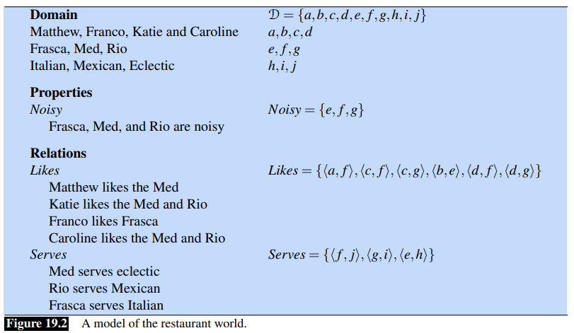
Objects denote elements of the domain • Properties denote sets of elements of the domain • Relations denote sets of tuples of elements of the domain

Slide 12
First Order Logic
FOPC is a flexible, well-understood, and computationally tractable approach to the representation of knowledge that satisfies many of the requirement raised previously for a meaning representation language.
It provides a sound computational basis for the verifiability, inference, and expressiveness requirement.
The most attractive feature of FOPC
  It makes very few specific commitments as to how tings ought to be represented.

Slide 13
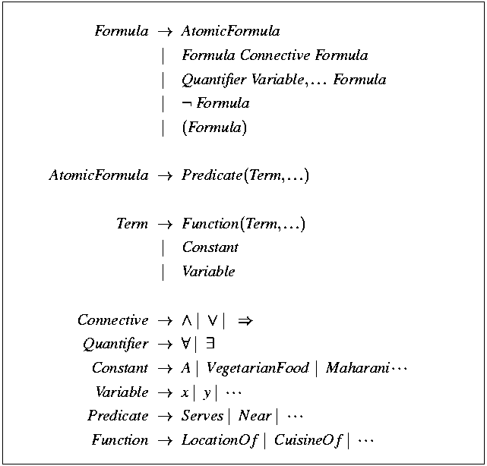
Basic Elements of First-Order Logic
Representing Meaning

Slide 14
Basic Elements of First-Order Logic
Term
  Constants
    Specific objects in the world being described
    Ａ, B, Maharani, Harry
  Functions
    Concepts often expressed in English as genitives,
      the location of Maharani, or Maharani’s location
      LocationOf(Maharani)
    Referring to unique objects, though appearing similarly as predicates
  Variables
    Objects without having to make references to any particular objects
    Depicted as single lower-case letters

Slide 15
Relations hold among objects
  Predicates are symbols refer to, or name, the relations that hold among some fixed number of objects in a given domain.
    Serves(Maharani,VegetarianFood)
    Restaurant(Maharani)
  Atomic formula
  Complex formula, through the use of logical connectives
    Have(Speaker, FiveDollars) ∧ ¬Have(Speaker, LotOfTime)

Slide 16
Variables and Quantifiers
Variables are used in FOPC
  To refer to particular anonymous objects and
  To refer generically to all objects in a collection
The two uses are made possible through the use of quantifiers.
  a restaurant that serves Mexican food near ICSI
  ∃x Restaurant(x) ∧
  Serves(x, MexicanFood) ∧ Near(LocationOf(x), LocationOf(ICSI))
  AyCaramba is a Mexican restaurant near ICSI, then substituting AyCaramba for x
  Restaurant(AyCaramba)∧Serves(AyCaramba,MexicanFood) ∧Near((LocationOf(AyCaramba),LocationOf(ICSI))
  All vegetarian restaurants serve vegetarian food.
  ∀x VegetarianRestaurant(x) ⇒ Serves(x, VegetarianFood)
Frasca, is a restaurant
Restaurant(Frasca)

Slide 17
∀xItalianRestaurant(x) → Restaurant(x)∧(∃yServes(x, y)∧ItalianCuisine(y))

Slide 18
Lambda Notation
The final element we need to complete our discussion of FOL is called the lambda notation.
The lambda notation extends the syntax of FOL to include expressions of the following form: λx.P(x)
Such expressions consist of the Greek symbol λ, followed by one or more variables, followed by a FOL formula that makes use of those variables
The usefulness of these λ-expressions is based on the ability to apply them to logical terms to yield new FOL expressions where the formal parameter variables are bound to the specified terms.
This process is known as λ-reduction, and consists of a simple textual replacement of the λ variables and the removal of the λ.

Slide 19
The following expressions illustrate the application of a λ-expression to the constant A, followed by the result of performing a λ-reduction on this expression:
λx.P(x)(A)
P(A)
he following expressions illustrate a single λ-application and subsequent reduction with this kind of embedded λ-expression:
λx.λy.Near(x, y)(Bacaro)
λy.Near(Bacaro, y)
λy.Near(Bacaro, y)
(Centro) Near(Bacaro,Centro)
This general technique, called currying is a way of converting a predicate with multiple arguments into a sequence of single-argument predicates.

Slide 20
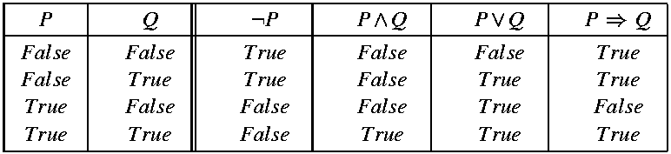
The Semantics of First-Order Logic
The various objects, properties, and relations presented on a FOPC knowledge base acquire their meanings by virtue of their correspondence to objects, properties, and relations out in the external would being modeled by the knowledge base.
  FOPC sentences can therefore be assigned a value of True or False
The interpretations of formulas involving logical connectives is based on the meaning of the components in the formulas combined with the meaning of connectives they contain.

Slide 21


Inference
Inference
  The ability to add valid new propositions to a knowledge base, or
  To determine the truth of propositions not explicitly contained within a knowledge base.
Modus ponens : informally known as if-then reasoning
we will refer to the left-hand side of an implication as the antecedent and the right-hand side as the consequent.
VegetarianRestaurant(Leaf) matches the antecedent of the rule, thus allowing us to use modus ponens to conclude Serves(Leaf ,VegetarianFood).

Slide 22
Forward chaining systems
As individual facts are added to the knowledge base, modus ponens is used to fire all applicable implication rules.
These new propositions in turn can be used to fire implication rules applicable to them. The process continues until no further facts can be deduced.
The forward chaining approach has the advantage that facts will be present in the knowledge base when needed, because, in a sense all inference is performed in advance.
  Production systems
The disadvantage of this approach is that facts that will never be needed may be inferred and stored.

Slide 23
Backward chaining systems
In backward chaining, modus ponens is run in reverse to prove specific propositions called queries.
The first step is to see if the query formula is true by determining if it is present in the knowledge base.
If it is not, then the next step is to search for applicable implication rules present in the knowledge base.
  Prolog programming language
While forward and backward reasoning are sound, neither is complete.
This means that there are valid inferences that cannot be found by systems using these methods alone.

Slide 24
Event and State Representations
States are conditions, or properties, that remain unchanged over an extended period of time, and events denote changes in some state of affairs.
The representation of both states and events may involve a host of participants, props, times and locations.
the representation for Leaf serves vegetarian fare consists of a single predicate with arguments for the entity doing the serving and the thing served.
Serves(Leaf ,VegetarianFare)
This approach assumes that the predicate used to represent an event verb has the same number of arguments as are present in the verb’s syntactic subcategorization frame

Slide 25
choosing the correct number of arguments for the predicate representing the meaning of eat is a tricky problem.
I ate.
I ate a turkey sandwich.
I ate a turkey sandwich at my desk.
I ate at my desk.
I ate lunch.
I ate a turkey sandwich for lunch.
I ate a turkey sandwich for lunch at my desk
choosing the correct number of arguments for the predicate representing the meaning of eat is a tricky problem.
Unfortunately, predicates in FOL have fixed arity – they take a fixed number of arguments.

Slide 26
To address this problem, we introduce the notion of an event variable to allow us to make assertions about particular events.
∃e Eating(e) ∧ Eater(e,Speaker)∧Eaten(e,TurkeySandwich)
the quantified variable e stands for the eating event and is used to bind the event predicate with the core information provided via the named roles Eater and Eaten.
To handle the more complex examples, we simply add additional relations to capture the provided information
∃e Eating(e) ∧ Eater(e,Speaker)∧Eaten(e,TurkeySandwich) (19.46) ∧ Meal(e,Lunch)∧Location(e,Desk)
Event representations of this sort are referred to as neo-Davidsonian event representations.

Slide 27
Summarizing the neo-Davidsonian approach to event representations:
Events are captured with predicates that take a single event variable as an argument
There is no need to specify a fixed number of arguments for a given FOL predicate; rather, as many roles and fillers can be glued on as are provided in the input.
No more roles are postulated than are mentioned in the input.
The logical connections among closely related inputs that share the same predicate are satisfied without the need for additional inference.

Slide 28
Description Logics
Description Logics refers to a family of logical approaches that correspond to varying subsets of FOL.
The restrictions placed on the expressiveness of Description Logics serve to guarantee the tractability of various critical kinds of inference.
When using Description Logics to model an application domain, the emphasis is on the representation of knowledge about categories, individuals that belong to those categories, and the relationships that can hold among these individuals.
The set of categories, or concepts, that make up a particular application domain is called terminology its terminology.

Slide 29
The portion of a knowledge base that contains the terminology is traditionally called the TBox; this is in contrast to the ABox that contains facts about individuals.
The terminology is typically arranged into a hierarchical organization called an ontology that captures the subset/superset relations among the categories.
Once we’ve specified the categories of interest in a particular domain, the next step is to arrange them into a hierarchical structure.
There are two ways to capture the hierarchical relationships present in a terminology:
we can directly assert relations between categories that are related hierarchically, or
we can provide complete definitions for our concepts and then rely on inference to provide hierarchical relationships.

Slide 30
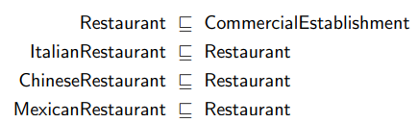
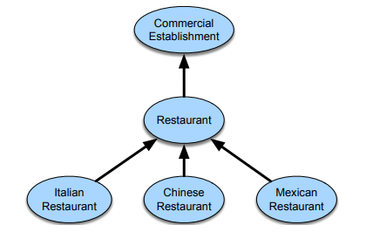
To directly specify a hierarchical structure, we can assert subsumption relations between the appropriate concepts in a terminology.
The subsumption relation is conventionally written as C D and is read as C is subsumed by D; that is, all members of the categoryC are also members of the category D.
A graphical network representation of a set of subsumption relations in the restaurant domain. subsumption relations are denoted by links between the nodes representing the categories.

Slide 31
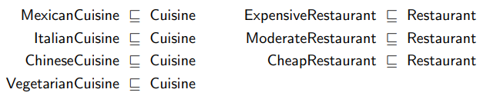
let’s first add some new concepts to our terminology to represent various kinds of cuisine.
revise our earlier version of ItalianRestaurant to capture cuisine information

Slide 32


we might explicitly provide a definition for ItalianRestaurant as being those restau_x0002_rants that serve Italian cuisine, and ModerateRestaurant as being those whose price range is moderate
the superficially similar case of vegetarian restaurants. Clearly, vegetarian restaurants are those that serve vegetarian cuisine.

Slide 33
Word Senses
A sense (or word sense) is a discrete representation of one aspect of the meaning of a word.
we represent each sense with a superscript: bank¹ and bank² , mouse¹ and mouse².
mouse¹ : .... a mouse controlling a computer system in 1968.
mouse² : .... a quiet animal like a mouse
bank¹ : ...a bank can hold the investments in a custodial account ...
bank² : ...as agriculture burgeons on the east bank, the river ...

Slide 34
Defining Word Senses
we need to consider the alternative ways that dictionaries and thesauruses offer for defining senses.
One is based on the fact that dictionaries or thesauruses give textual definitions for each sense called glosses.
Here are the glosses for two senses of bank:
1. financial institution that accepts deposits and channels the money into lending activities
2. sloping land (especially the slope beside a body of water)
The second way that thesauruses offer for defining a sense is—like the dictionary definitions—defining a sense through its relationship with other senses.
For example, the above definitions make it clear that right and left are similar kinds of lemmas that stand in some kind of alternation, or opposition, to one another.

Slide 35
Glosses are not a formal meaning representation; they are just written for people. Consider the following fragments from the definitions of right, left, red, and blood from the American Heritage Dictionary
right adj. located nearer the right hand esp. being on the right when facing the same direction as the observer.
left adj. located nearer to this side of the body than the right.
red n. the color of blood or a ruby.
blood n. the red liquid that circulates in the heart, arteries and veins of animals.
The definition of right makes two direct references to itself, and the entry for left contains an implicit self-reference in the phrase this side of the body, which presumably means the left side.
The entries for red and blood reference each other in their definitions.

Slide 36
How many senses do words have?
Dictionaries and thesauruses give discrete lists of senses.
creating a thesaurus depends on criteria for deciding when the differing uses of a word should be represented with discrete senses.
consider two senses discrete if they have independent truth conditions, different syntactic behavior, and independent sense relations, or if they exhibit antagonistic meanings.
Consider the following uses of the verb serve from the WSJ corpus:
They rarely serve red meat, preferring to prepare seafood.
He served as U.S. ambassador to Norway in 1976 and 1977.
He might have served his time, come out and led an upstanding life.
The serve of serving red meat and that of serving time clearly have different truth conditions and presuppositions; the serve of serve as ambassador has the distinct subcategorization structure serve as NP.
if two senses are distinct is to conjoin two uses of a word in a single sentence; this kind of conjunction of antagonistic readings is called zeugma.

Slide 37
Relations Between Senses
Synonymy
when two senses of two different words (lemmas) are identical, or nearly identical, we say the two senses are synonyms.
couch/sofa vomit/throw up filbert/hazelnut car/automobile
synonymy is actually a relationship between senses rather than words.
Considering the words big and large.
These may seem to be synonyms in the following sentences, since we could swap big and large in either sentence and retain the same meaning:
How big is that plane?
Would I be flying on a large or small plane?

Slide 38

Antonymy:
Whereas synonyms are words with identical or similar meanings, antonyms are words with an opposite meaning, like:
long/short big/little fast/slow cold/hot dark/light rise/fall up/down in/out
A word is a hyponym of another word or sense if the first is more specific, denoting a subclass of the other.
For example, car is a hyponym of vehicle, dog is a hyponym of animal
Conversely, we say that vehicle is a hypernym of car, and animal is a hypernym of dog.
the two words (hypernym and hyponym) are very similar and hence easily confused; for this reason, the word superordinate is often used instead of hypernym.

Slide 39
Hypernymy can also be defined in terms of entailment.
Under this definition, a sense A is a hyponym of a sense B if everything that is A is also B, and hence being an A entails being a B, or
∀x A(x) ⇒ B(x).
Hyponymy/hypernymy is usually a transitive relation;
if A is a hyponym of B and B is a hyponym of C, then A is a hyponym of C. Another name for the hypernym/hyponym structure is the IS-A hierarchy, in which we say A IS-A B, or B subsumes A.
Hypernymy is useful for tasks like textual entailment or question answering; knowing that leukemia is a type of cancer, for example, would certainly be useful in answering questions about leukemia.

Slide 40
meronymy
the part-whole relation
A leg is part of a chair; a wheel is part of a car. We say that wheel is a meronym of car, and car is a holonym of wheel.
Structured Polysemy
The senses of a word can also be related semantically, in which case we call the relationship between them structured polysemy. Consider this sense bank:
The bank is on the corner of Nassau and Witherspoon.
This sense, perhaps bank⁴ ,means something like “the building belonging to a financial institution”.
Thus, there is a systematic relationship between senses that we might represent as BUILDING ↔ ORGANIZATION

Slide 41
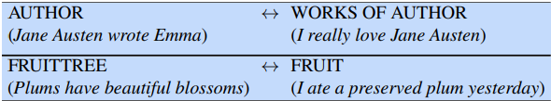
Metonymy is the use of one aspect of a concept or entity to refer to other aspects of the entity or to the entity itself.
We are performing metonymy when we use the phrase the White House to refer to the administration whose office is in the White House. Other common examples of metonymy include the relation between the following pairings of senses:

Slide 42
WordNet: A Database of Lexical Relations
The most commonly used resource for sense relations in English and many other languages is the WordNet lexical database.
English WordNet consists of three separate databases, one each for nouns and verbs and a third for adjectives and adverbs; closed class words are not included.
Each database contains a set of lemmas, each one annotated with a set of senses.
The WordNet 3.0 release has 117,798 nouns, 11,529 verbs, 22,479 adjectives, and 4,481 adverbs.
The average noun has 1.23 senses, and the average verb has 2.16 senses.

Slide 43
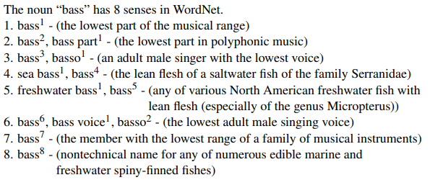
The set of near-synonyms for a WordNet sense is called a synset (for synonym set);
synsets are an important primitive in WordNet.
The entry for bass includes synsets like {bass1 , deep6}, or {bass6 , bass voice1 , basso2}.

Slide 44
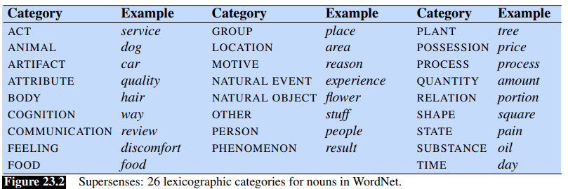

Slide 45
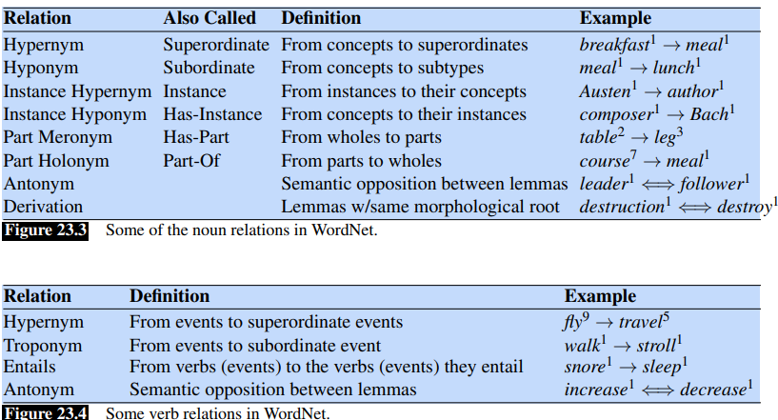

Slide 46
